Slide 1
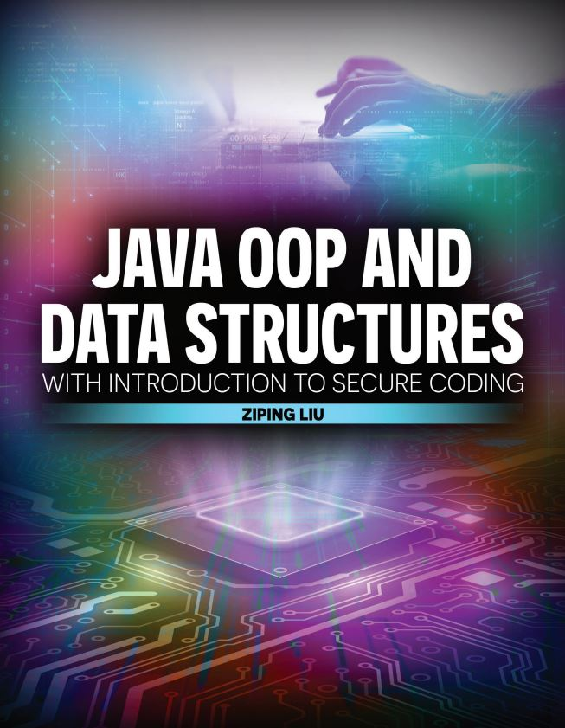

Slide 2

Java OOP and Data Structures with Introduction to Secure Coding Dr. Ziping Liu
Chapter 8 I/O

Slide 3
https://he.kendallhunt.com/product/java-oop-and-data-structures-introduction-secure-coding
Chapter 8 I/O

Slide 4

Chapter Outlines
Working with streams of data
Using character streams
Enhancing efficiency with buffered streams
Tokenizing streams of data with Scanner
Working with structured data as byte streams
Processing primitive data with data streams
Processing objects with object streams
Performing I/O over the Internet (available on the supplemental website)
Reading HTML data from a URL address
Applying the functional programming paradigm
Reading in Internet images

Slide 5

8.1 Data as a Stream
A stream is a flow of data or information, and it can be represented with simple bytes, characters, or complex objects.
Java I/O “opens up” a stream of data: read input or write output, one “chunk” of data at a time
byte stream, character streams, buffered streams, and object streams
opening the stream, consuming the stream, and closing the stream: may run into IOExceptions

Slide 6
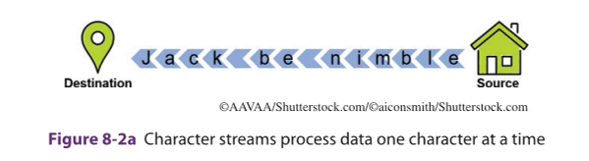
8.1 Data as a Stream
Character Streams
data that consists of character values
Two classes handle files with characters: java.io.FileReader and java.io.FileWriter
Reader is the supertype of all input character stream objects in Java
Writer is the supertype of all output character stream objects in Java
A special character, ‘-1’ represents the end of the file

Slide 7
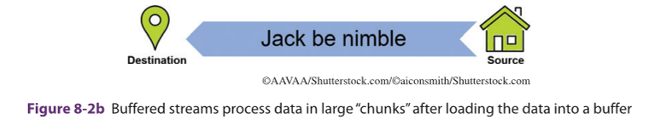
8.1 Data as a Stream
Buffered Streams
can improve I/O efficiency
java.io.BufferedReader and java.io.BufferedWriter

Slide 8
8.2 Tokenizing with Scanner
a Scanner object in Java parses primitive types and Strings into tokens using regular expressions.
the Scanner uses delimiters. The default delimiter is whitespace (or the metacharacter “\s”).
The “next” methods retrieve tokens one-by-one and attempt to parse the tokens into the correct form (e.g. integer, float, boolean, etc.), throwing exceptions if the retrieved “next” token is not of the correct form.

Slide 9
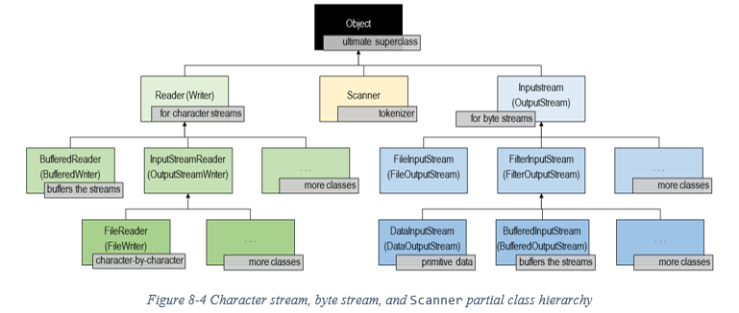
8.3 Using Byte Streams to Work with Structured Data

Slide 10
8.3 Using Byte Streams to Work with Structured Data
Processing Structured Data with Data Streams
DataInputStream and DataOutputStream—are subtypes of InputStream and OutputStream
handle structured data consisting of primitive data types (such as integers, floats, booleans, etc.) and Strings
No need to use Scanner for tokenization
when working with structured data files, it is important that the contents are written and retrieved with the method that aligns with the data type

Slide 11
8.3 Using Byte Streams to Work with Structured Data
Processing Objects with Object Streams
ObjectOutputStream and ObjectInputStream
use object streams to transform objects into byte streams
more flexible than data streams

Slide 12


Slide 13


Slide 14
Which National Park is it?
Answer: Crater Lake National Park

